Slide 1




aehhc
NEXT GEN EMPLOYABILITY PROGRAM
Creating a future-ready workforce
Team Members
College Name
Arunachala college of engineering
For women
Student Name :S.Sahaya Sacksi Parimala.
Student ID : au960221104101

Slide 2

CAPSTONE PROJECT SHOWCASE
Project Title
Car Rentals Application with Django Framework
Abstract | Problem Statement | Project Overview | Proposed Solution | Technology Used | Modelling & Results | Conclusion

Slide 3
Abstract
This project endeavors to develop a user-friendly web application for car rentals using the Django framework. The application will feature robust backend functionalities such as secure user authentication, efficient database management, and seamless payment processing. On the frontend, customers will benefit from an intuitive interface allowing for easy searching, filtering, and booking of rental vehicles. Real-time updates on availability and pricing will enhance the user experience. Priority will be given to ensuring data security and privacy, with a responsive design ensuring compatibility across various devices. Additionally, an admin dashboard will be provided to empower rental agencies in managing their fleet and reservations efficiently. Through meticulous planning, development, and testing, this project aims to revolutionize the car rental industry by providing a modern and efficient solution for agencies and customers alike.
Source :

Slide 4
Problem Statement
The traditional car rental industry relies on manual booking processes, leading to inefficiencies, inaccuracies, and customer dissatisfaction. Finding available vehicles and managing bookings is time-consuming and error-prone, hindering operational effectiveness. Additionally, security concerns surrounding payment processing and data management pose risks to customer privacy and trust. The lack of real-time updates on vehicle availability exacerbates these challenges, resulting in missed opportunities and revenue loss for rental agencies.
Source :

Slide 5
Project Overview
"Streamlining Car Rentals" is a comprehensive web application developed using the Django framework, aiming to modernize and optimize the car rental experience. The application offers a user-friendly platform for both rental agencies and customers, featuring seamless booking processes, real-time availability updates, and secure payment processing. Key components include a centralized booking system, intuitive frontend interface, robust backend management, and integration of real-time vehicle availability updates. Through meticulous design, development, and testing, the project aims to revolutionize the car rental industry by providing efficiency, transparency, and convenience for all stakeholders involved.
Source :

Slide 6
Proposed Solution
.
The solution entails developing an automated car rental management system to address industry challenges. This system streamlines booking processes, enhances data security, and provides real-time updates for operational efficiency and customer satisfaction. Features include a centralized booking platform, real-time availability tracking, secure payment processing, and robust data security measures. With a user-friendly interface, automated booking management, and reporting analytics, the system optimizes operations while ensuring compliance with data protection regulations. By leveraging technology, the solution revolutionizes the car rental experience, offering efficiency and convenience for both rental agencies and customers.
Source :

Slide 7
Key Components:
Centralized Booking Platform:
Develop a centralized platform for customers to search, book, and manage rental reservations seamlessly.
Real-Time Availability Tracking:
Implement a system to provide instant updates on vehicle availability, minimizing the risk of double bookings and enhancing customer satisfaction.
Secure Payment Gateway:
Integrate a secure payment gateway to facilitate online transactions securely, protecting customer payment information.
Source :

Slide 8
Benefits:
Enhanced operational efficiency through streamlined booking processes-
Real-time updates on vehicle availability reduce waiting times
Secure payment processing instills trust and confidence-
Improved customer satisfaction and loyalty-
Optimal resource allocation maximizes revenue potential
Valuable insights from reporting and analytics features
- Convenience and accessibility for customers with online booking
Competitive advantage in the market
Source :

Slide 9


Technology Used
Front-end
Back-end
Source :

Slide 10
Modelling & Results
Modeling involved designing a comprehensive data model for efficient representation of vehicles, customers, reservations, and transactions. Backend development included user authentication, database management, and API implementation. A user-friendly frontend interface was created for vehicle search, booking, and reservation viewing. Real-time updates on availability were integrated through WebSocket or server-sent events. Secure payment processing was ensured through Stripe or PayPal integration. Testing involved unit and integration testing, while deployment utilized platforms like Heroku or AWS. Monitoring tools tracked performance metrics, and results were evaluated based on key performance indicators like booking volume and revenue. Iterative improvements were made based on feedback for continuous enhancement.
Source :

Slide 11
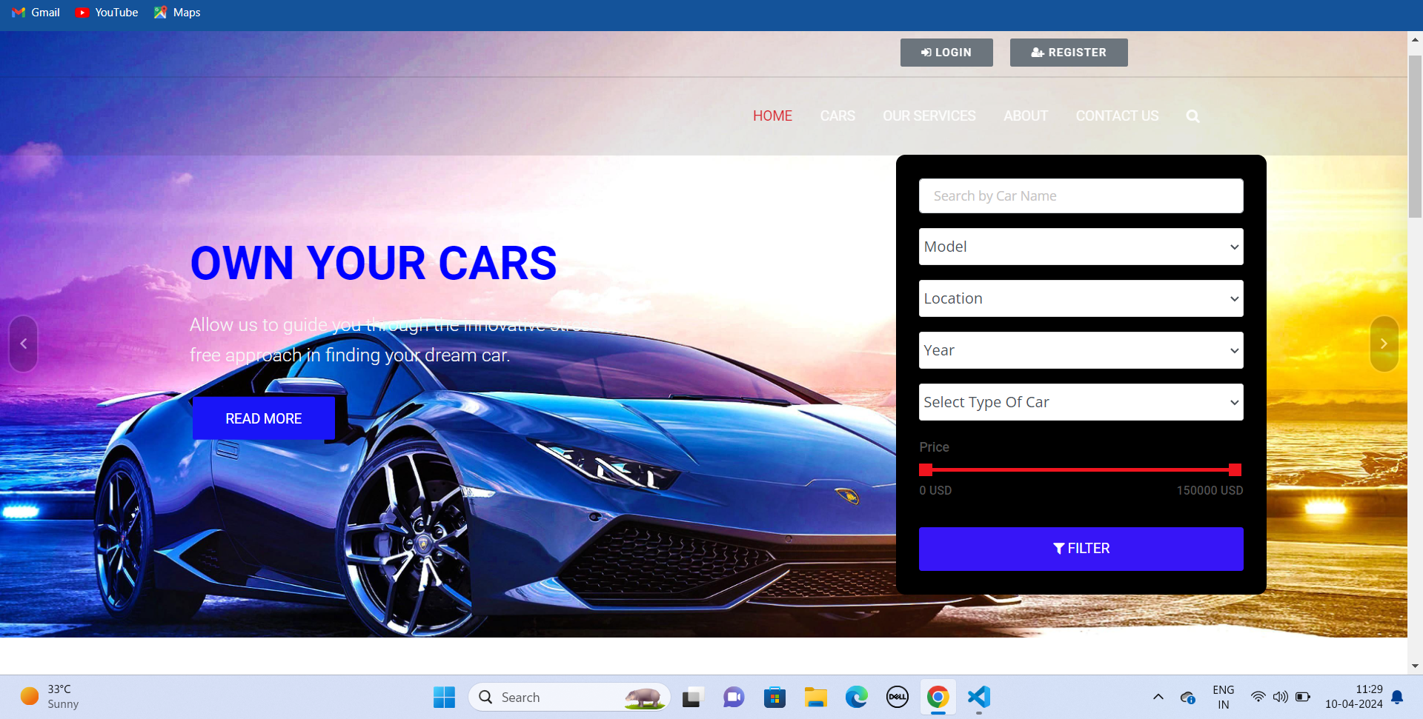
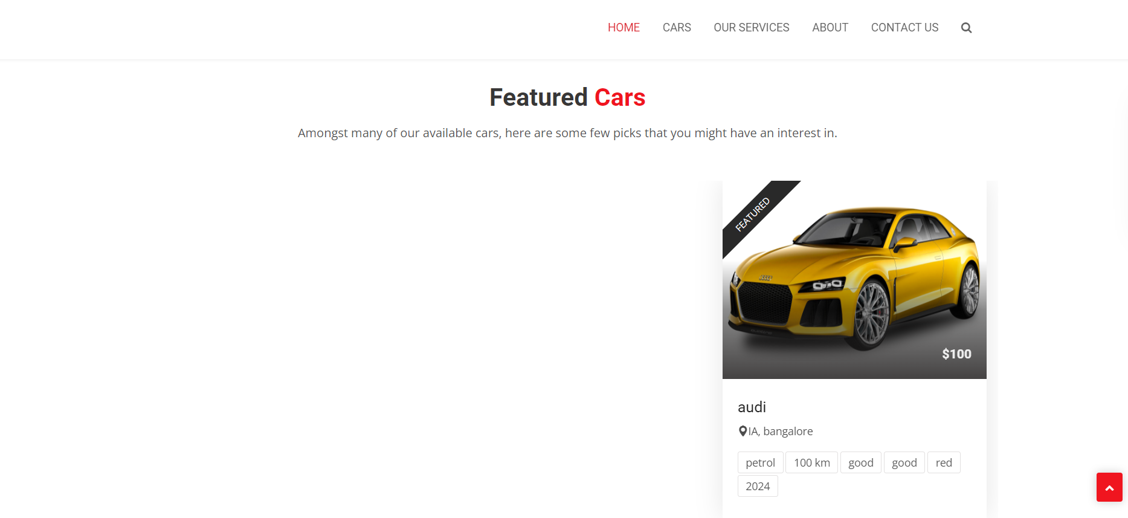
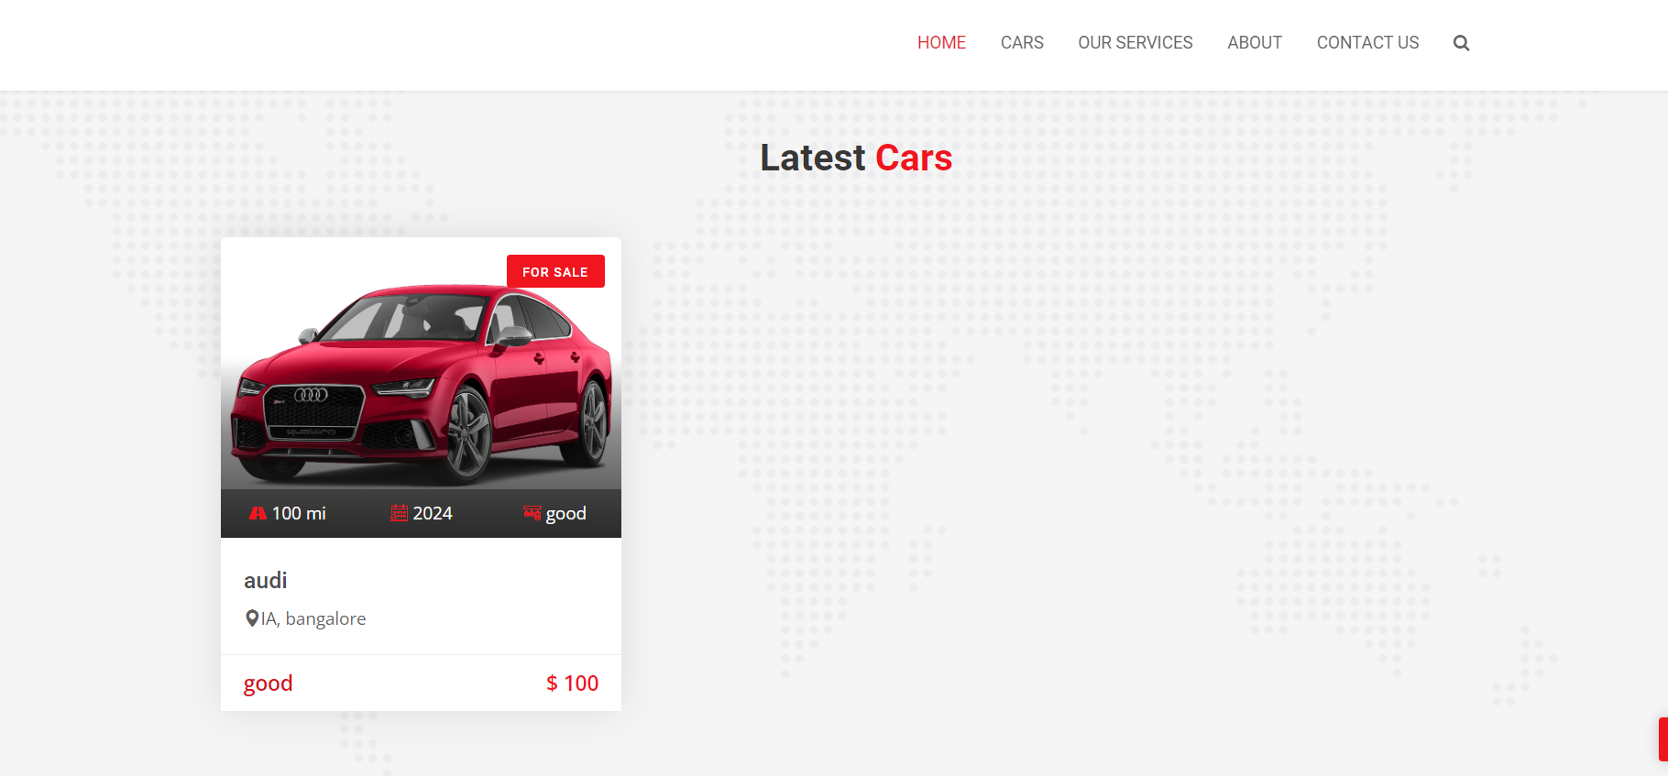
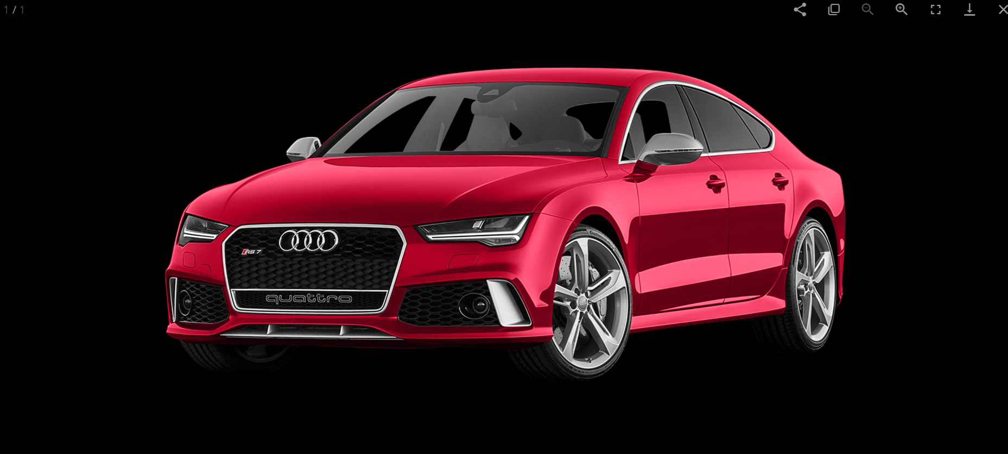
Homepage

Slide 12
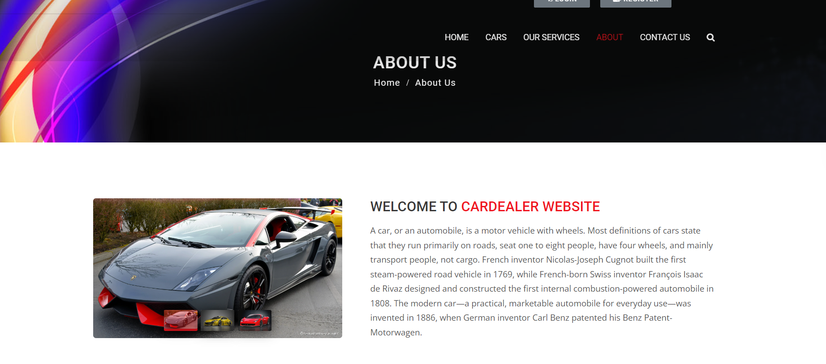
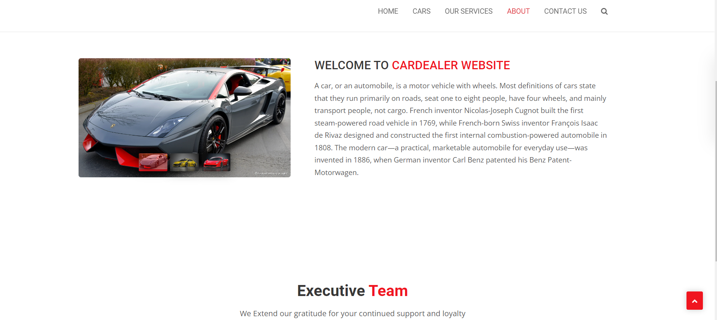
About-Us-Page

Slide 13
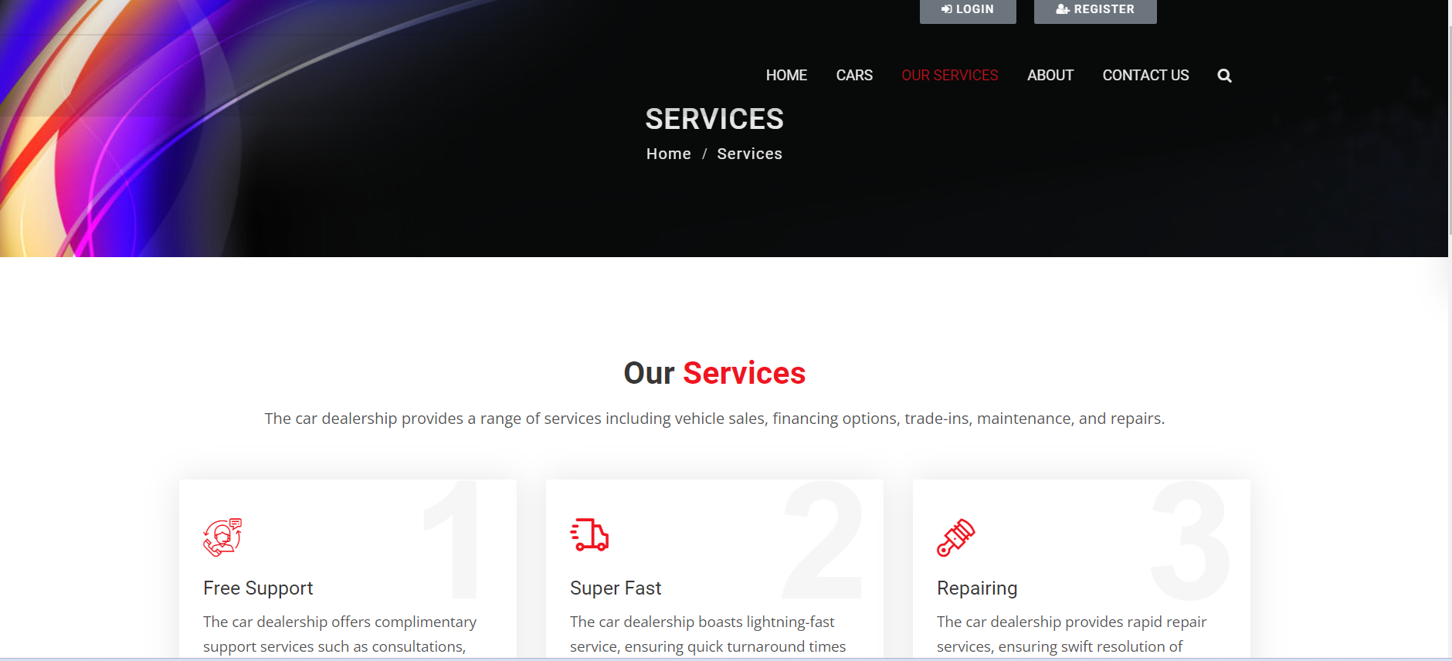
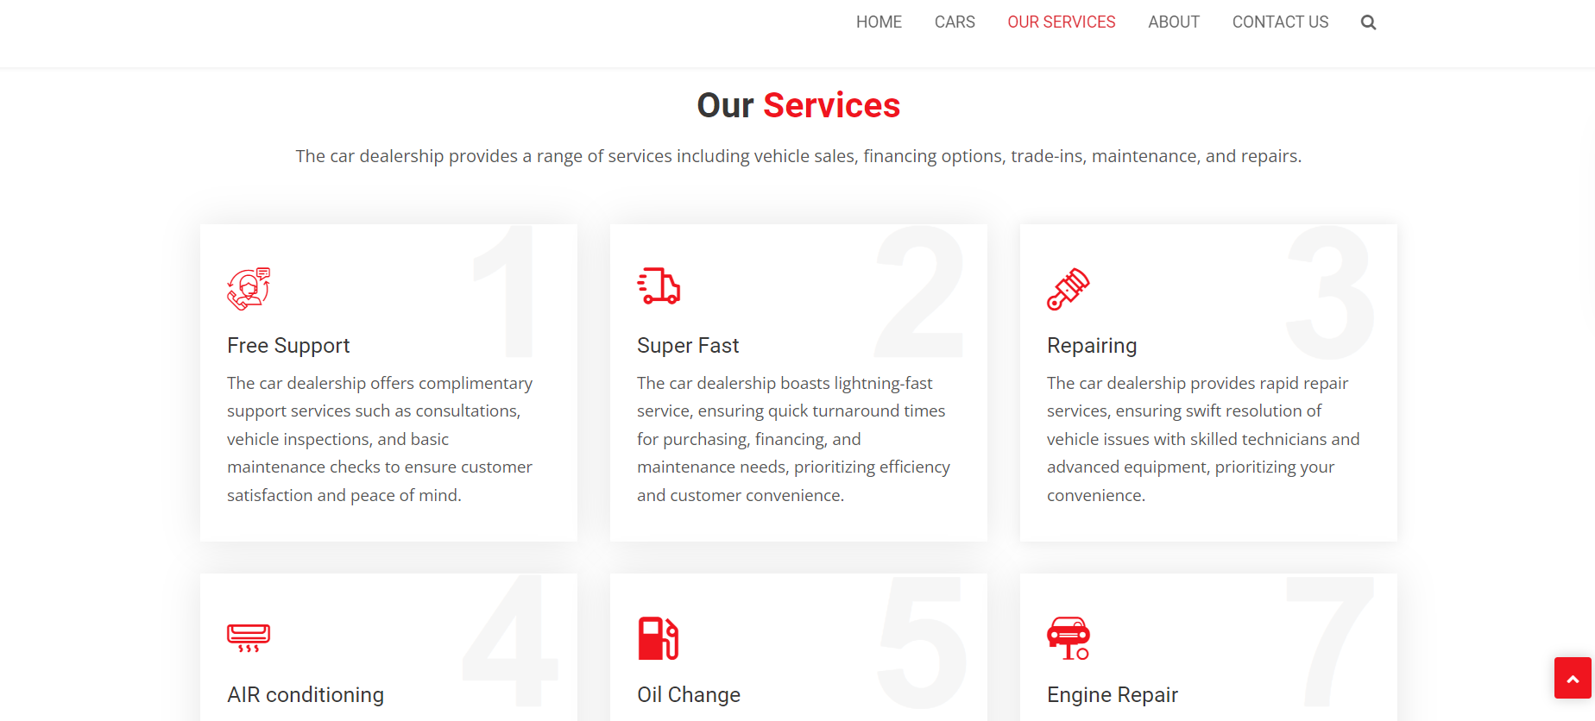
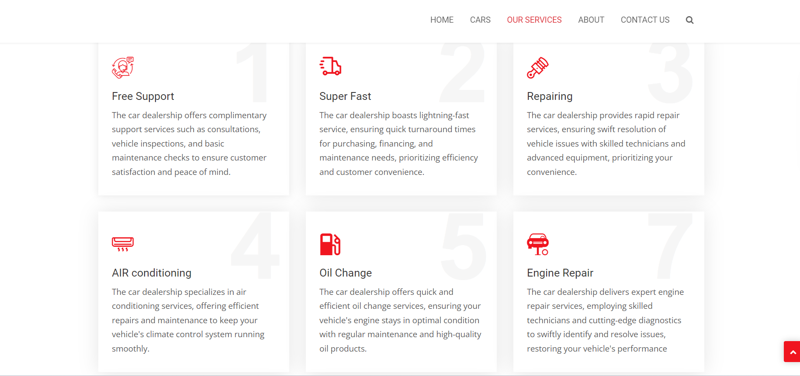
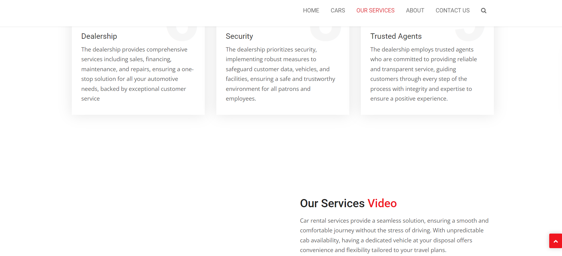
Service-Page

Slide 14
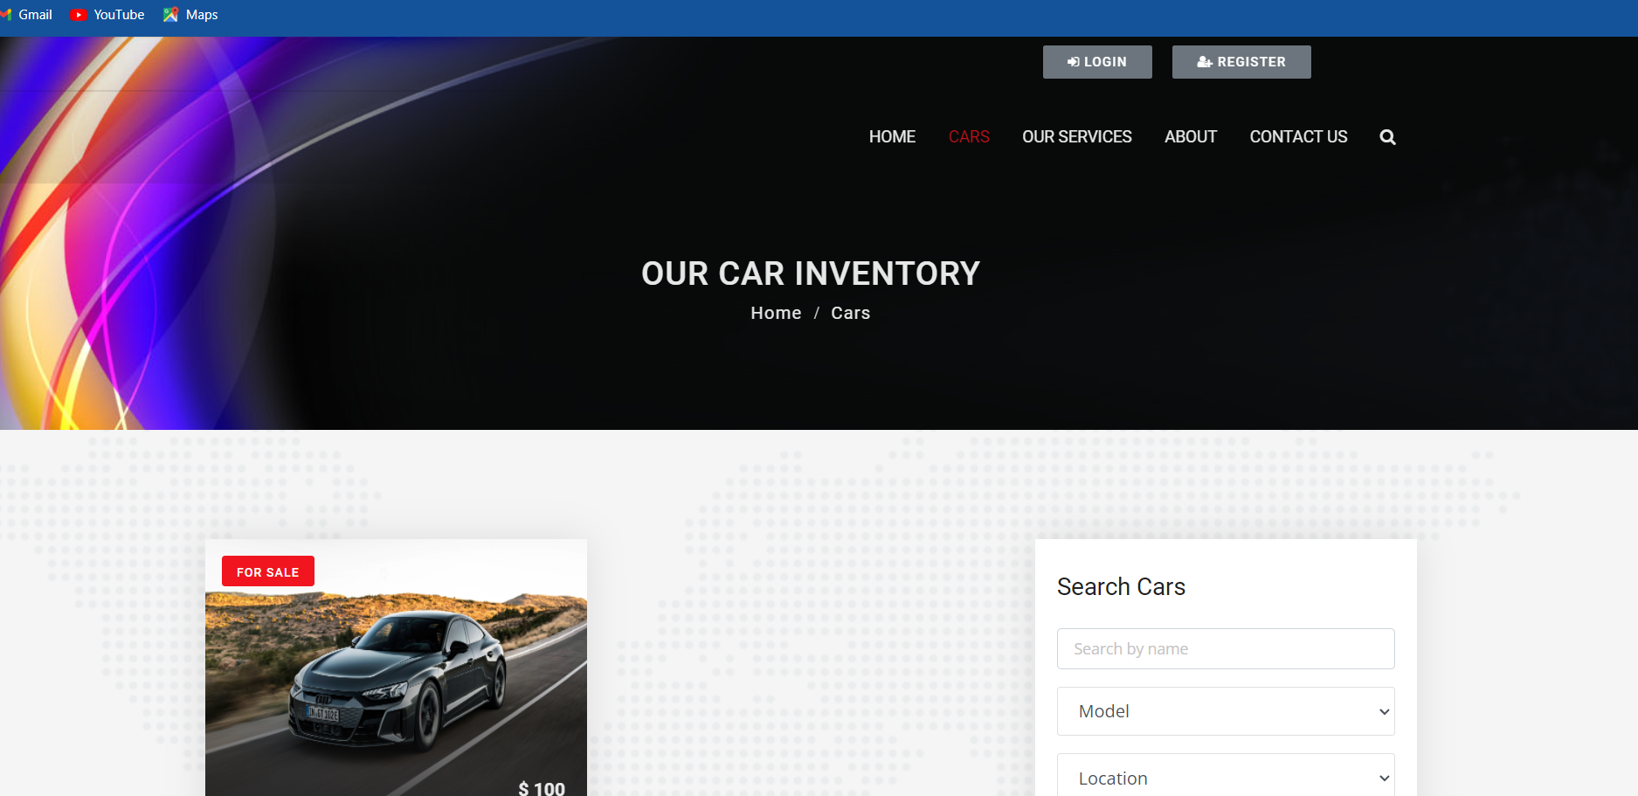

Cars

Slide 15

Contact Us

Slide 16
Future Enhancements:
AI-Powered Recommendations:
Implement machine learning algorithms to provide personalized vehicle recommendations based on customer preferences, enhancing the booking experience.
Augmented Reality (AR) Features:
Introduce AR technology to allow customers to visualize and customize their rental vehicles before booking, increasing engagement and satisfaction.
Enhanced Fleet Management:
Integrate IoT sensors to monitor vehicle health in real-time, enabling proactive maintenance and minimizing downtime.

Slide 17
Conclusion
The automated car rental management system represents a significant advancement in the industry, offering efficiency, convenience, and innovation for both rental agencies and customers. Through streamlined booking processes, real-time updates on vehicle availability, and secure payment processing, the system enhances operational effectiveness and customer satisfaction. Future enhancements, such as AI-powered recommendations and AR features, promise further improvements in the user experience and service offerings. Overall, the system's success lies in its ability to adapt to evolving customer needs and market trends, revolutionizing the car rental experience for years to come.
Source :

Slide 18
Thank You!
Notes:
Thank You !!

